Slide 1
Network Pruning and Interpretability
Teamprojekt Sommersemester 2024

Slide 2
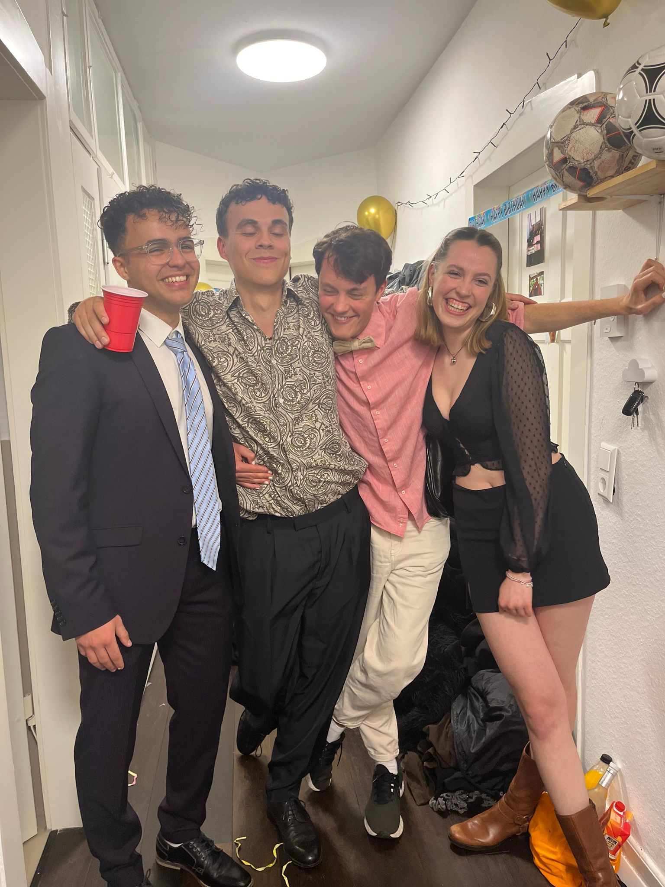

First sprint
(15.04.-29.04.2024)

Slide 3
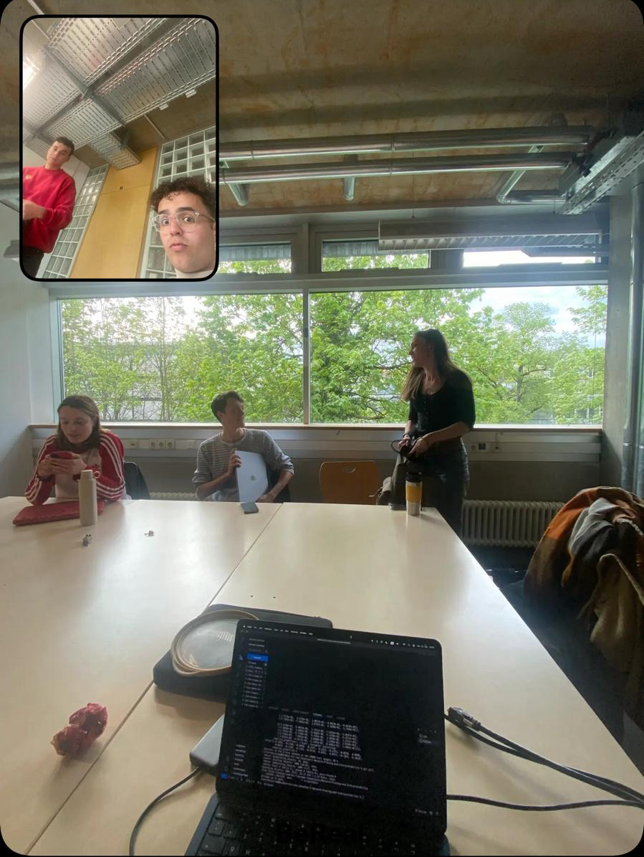
Sprint goals
Runnable and trained network
Use a sample dataset and ensure results are close to official data
Save and load the network with pytorch
Implement a random pruning mechanism
Demonstration

Slide 4
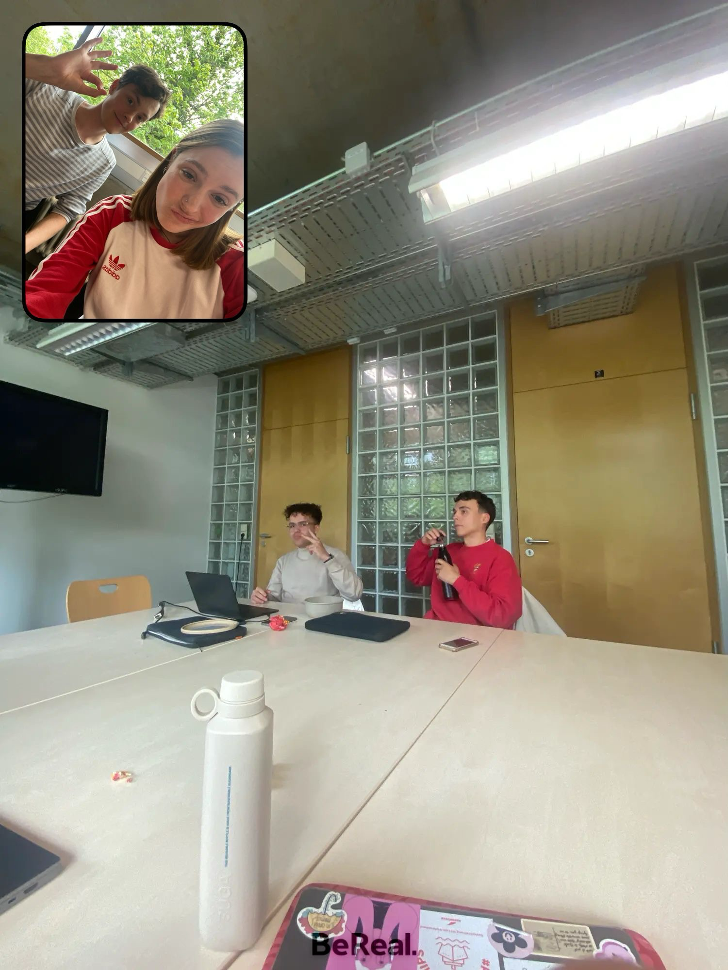
Team Blueprint
Erwartungen/Ziele:
-praktische Erfahrungen sammeln
-Netzwerke / Pruning verstehen
-Plan von der Materie -> ML Master
-Github besser lernen
-sehr gute Note
Wünsche
mehr Meetings --> gemeinsames Arbeiten
akademisches Feuer
rechtzeitig fertig werden/üben
Github organization pro acc
Lea neuer laptop
3) Teamarbeit
gute und gleichmäßige Teamarbeit
präsentierbares Ergebnis
Hilfsbereitschaft
niemand hängen lassen
offene, konstruktive Diskussionskultur
Einheit bilden
Spaß :)

Slide 5
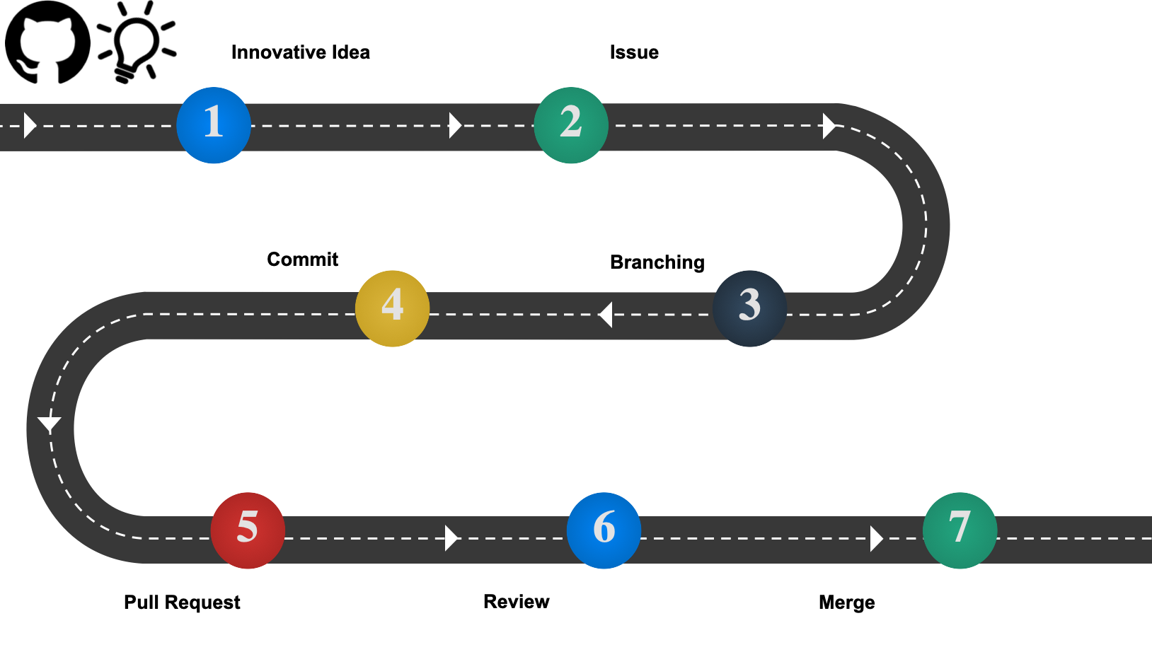
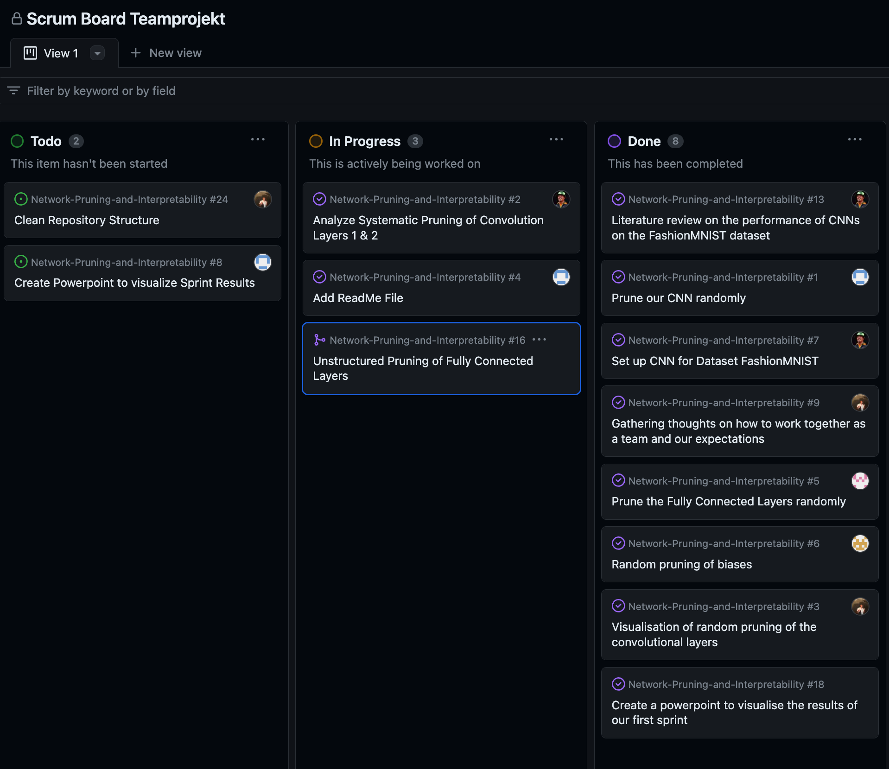
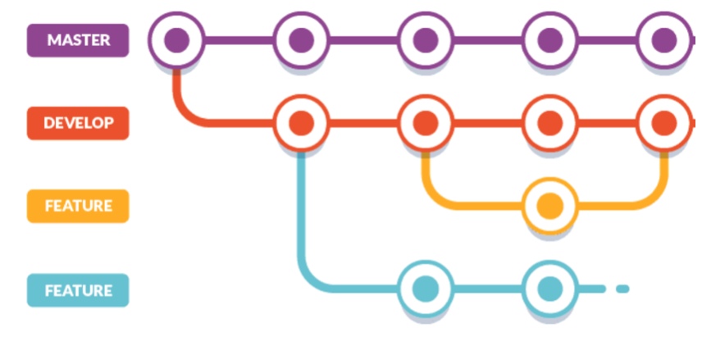
Workflow
Github workflow
Issue, PR, Review
Branching
Conventional Commits
Scrum Board
Coding best practices

Slide 6
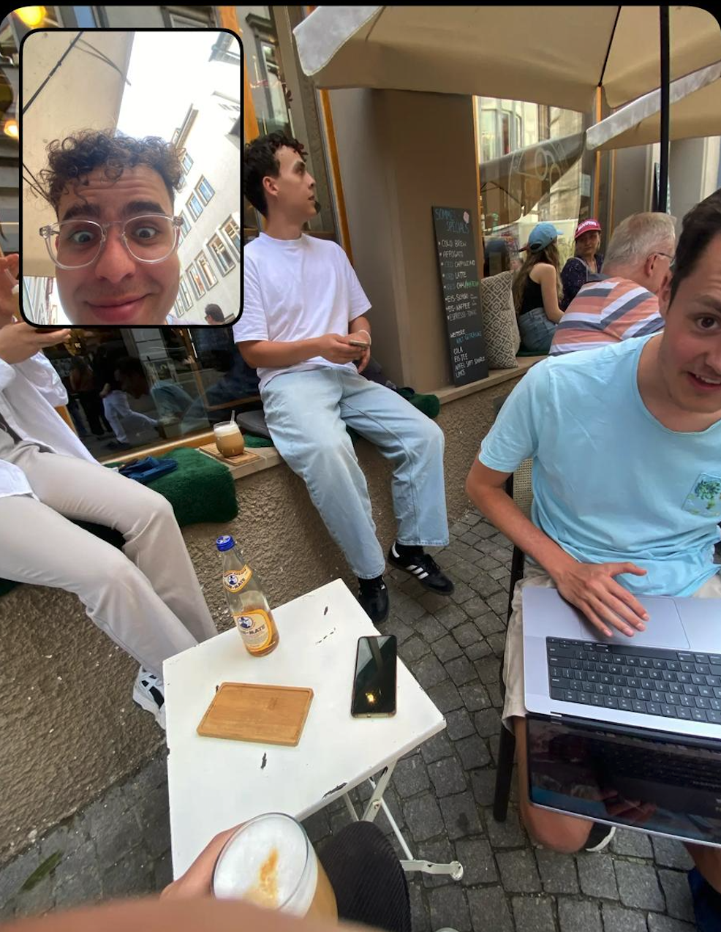
Set up the CNN
Loaded FashionMNIST dataset
used PyTorch Tutorial about Pruning (adapted some parameters, i.e. 1 instead of 3 input channels as FashionMNIST contains no RGB-images)
trained, saved and loaded network with pytorch command

Slide 7
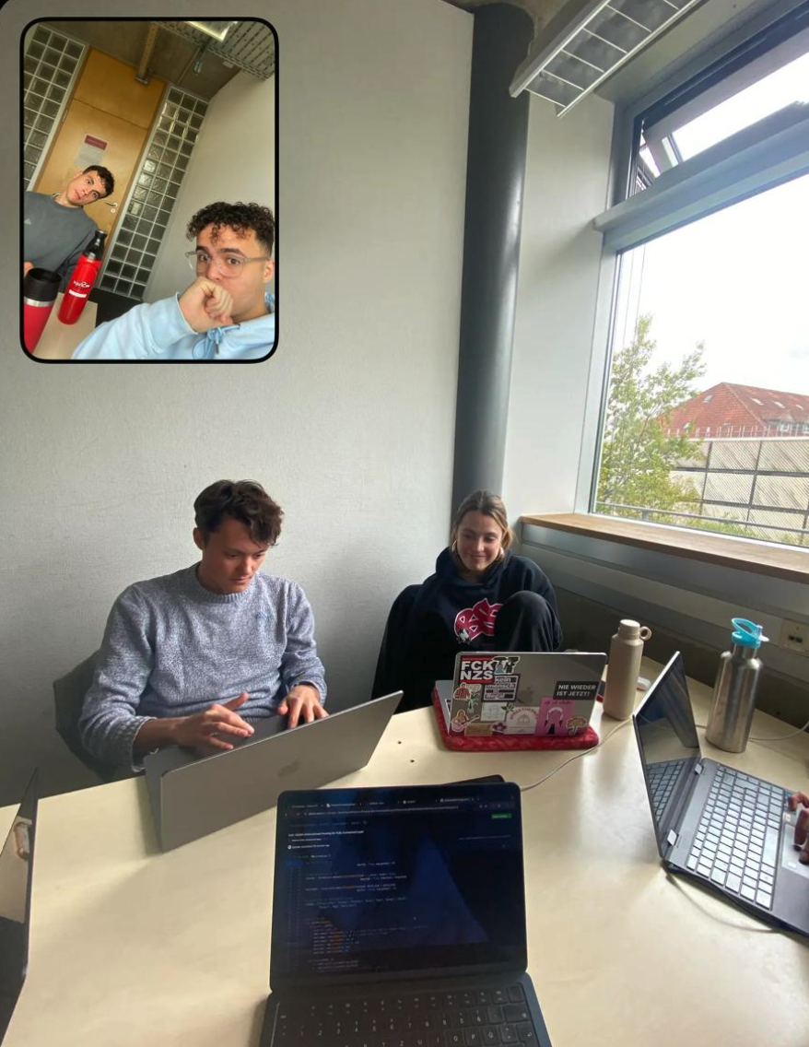
Literature review
We reached a mean accuracy of about ~87% for the unpruned CNN on FashionMNIST
In literature, most networks reach an accuracy between roughly 89% and 94% (depending on training size)
Best performance by “pFedBreD_ns_mg” in 2022: 99.06%

Slide 8
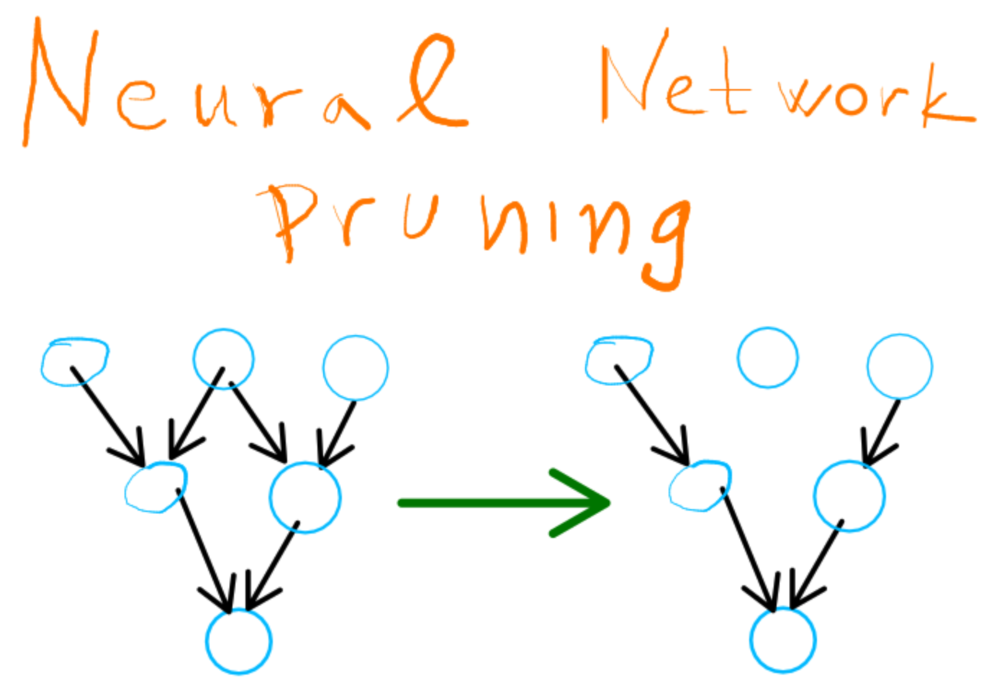
unstructured pruning (first try)
first: evaluated accuracy pre-pruning with varying batch sizes
then: accuracy post-random pruning on convolutional layer
-> only pruned weights (and only some values tested once)

Slide 9
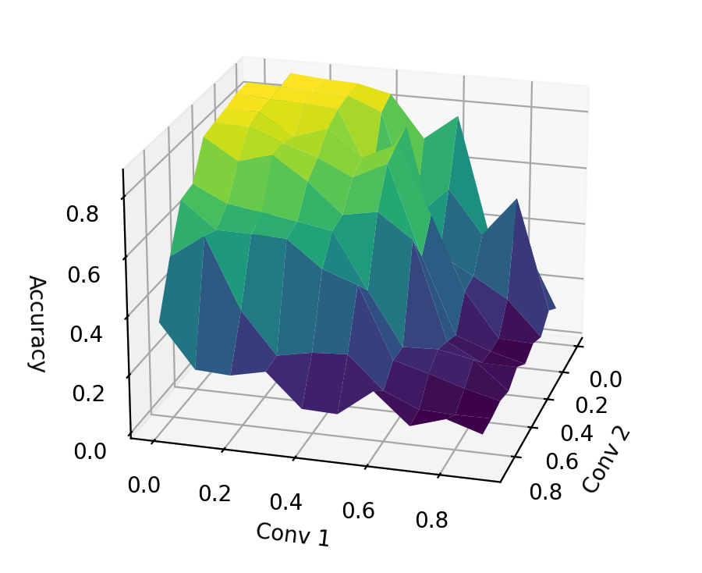
3D Plotting of Pruning Results for Conv Layers
conv layer 1 & 2 → 3d plot for accuracy
Importance of conv layer 1 is evident
Used Matplotlib
Uncertain about good visualization of multidimensional data

Slide 10
Implementing Systematic Pruning for the Conv Layers
Tidied up the code before implementing
Foundation: 3 for-loops (2 for the conv layers, 1 for the number of simulations ran = k)
Amounts of pruned parameters incremented by 10% each run
Makes a total of 10 parameters per loop => 100 possibilities * k simulations
Printed the mean accuracy and standard deviation for each parameter combination

Slide 11
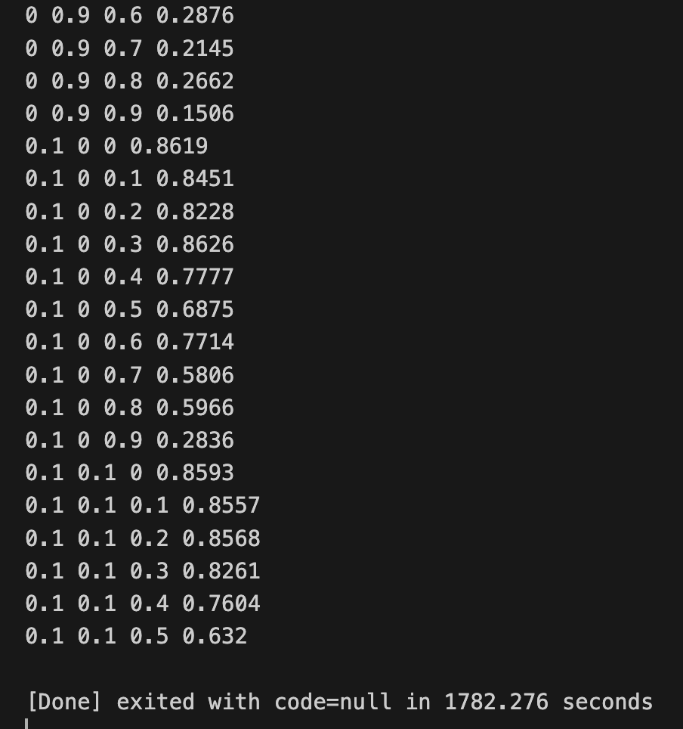
Fully Connected Layer Pruning
Extended Code for pruning the 3 Fully Connected Layers
-> e.g. triple nested for loop, printing each combination
of pruning rates
-> adding third dimension for storing and visualising results.
Specify pruning rates from 0% to 90% for the FC1, FC2, and FC3.
Ran the code for approx 30 minutes until the iteration of the last for loop began.

Slide 12
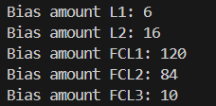
Bias pruning
Extended the code for pruning the biases of all layers (convolutional layer 1 & 2, fully connected layer 1, 2 & 3)
Pruning not the “weights” but “bias” randomly between 0 and 90%
Added three more loops for the fully connected layers
Added three more dimensions for storing the results
Couldn’t run the code myself as my laptop is slow as hell

Slide 13


Probleme und Schwierigkeiten

